Slide 1
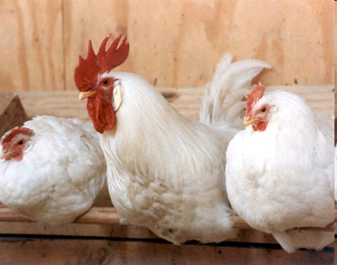
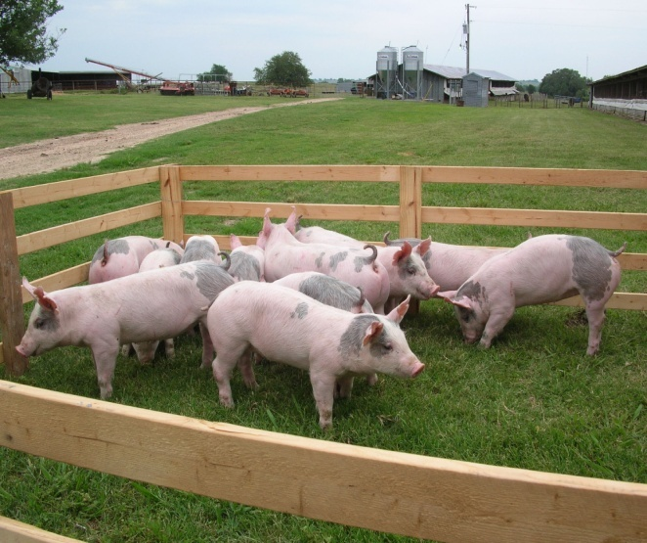
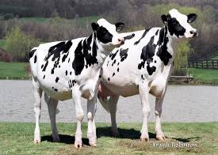
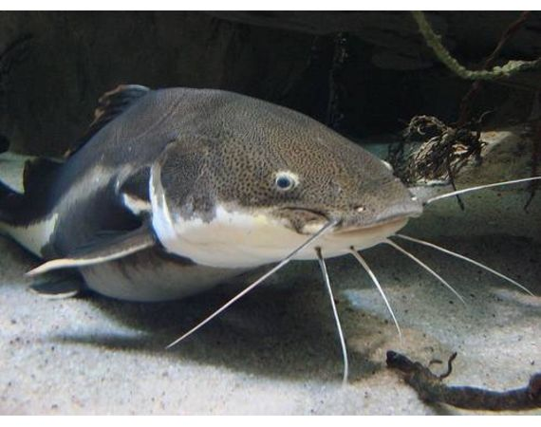
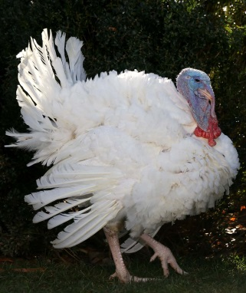


Assessing Antimicrobial Resistance Risks:
VICH GL 27 & FDA Guidance for Industry #152
Comments by
Heather Harbottle, Ph.D.
Microbial Food Safety Team (HFV-157)
Office of New Animal Drug Evaluation
Center for Veterinary Medicine

Slide 2
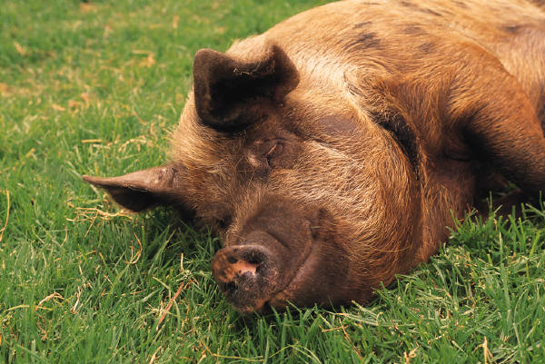
Uses of Antimicrobials in
Food-Producing Animals in the USA
Therapeutic uses to manage a specific disease for a prescribed duration of time:
  Treatment of a specific animal disease
  Control of a specific animal disease
  Prevention of a specific animal disease
April 2012: GFI #209 and December 2013: GFI #213
  FDA thinks that production uses of medically important antimicrobials are not judicious.
  December 2016: Removal of production indications for medically important antimicrobials was fully implemented

Slide 3
FDA Guidance for Industry #152: Evaluating the Safety of Antimicrobial New Animal Drugs with Regard to Their Microbiological Effects on Bacteria of Human Health Concern
Qualitative risk assessment approach
Assess antimicrobial drugs intended for food-producing animals regarding the development of resistance
Address human exposure to antimicrobial resistant microbes through ingestion of animal-derived food
Implemented in 2003
Goal: To provide safe use of antimicrobials in food animals while ensuring that significant human therapies are not compromised or lost.

Slide 4
Hazard Characterization
Qualitative Risk Assessment
Step 1. Release Assessment
Step 2. Exposure Assessment
Step 3. Consequence Assessment
Risk Estimation

Slide 5
 | GL 27 | GFI #152
Mechanism of activity | Basic Data | Release Assessment
Spectrum of activity | Basic Data | Release Assessment
PK/PD | Basic Data | Release Assessment
Resistance mechanisms | Basic Data | Release Assessment
Resistance transfer | Basic Data | Release Assessment
Co-selection | Basic Data | Release Assessment
Evaluation of Human Exposure | Additional Data | Exposure Assessment
Evaluation of Human Importance | Additional Data | Consequence Assessment

Slide 6

Hazard Identification
The hazard has been defined as human illness
caused by an antimicrobial-resistant bacterium,
attributable to an animal-derived food commodity,
treated with a human antimicrobial drug of concern.
In some instances, a hazard characterization is sufficient for a particular antimicrobial drug.

Slide 7
Foodborne Pathogens Commonly Addressed in GFI 152 Risk Assessments
Top pathogens transmitted by food (MMWR): Salmonella enterica serotypes and Campylobacter spp.
  Ground beef, Pork chops, Chicken breast, Ground turkey
Enterococcus spp. (Gram+ resistance marker)
Generic E. coli (Gram- resistance marker)
Other non-foodborne bacterial species if human therapy may be compromised by veterinary use of a particular drug

Slide 8
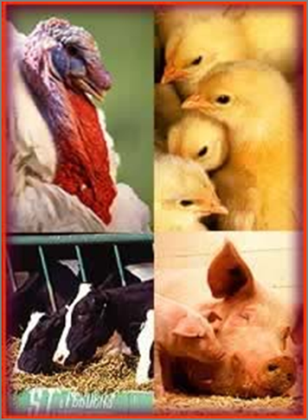



Qualitative Risk Assessment
Step 1: Release Assessment
Describes factors related to an antimicrobial drug and its use in animals that contribute to the emergence of resistant bacteria or resistant determinants in the animal

Slide 9
Release Assessment Parameters
Evaluation of data describing:
  Mechanism of Activity – Class of Drug, targeted action
  Spectrum of Activity – Gram +/- activity, susceptibility data
  Pharmacokinetics/Pharmacodynamics: ADME (absorption, distribution, metabolism and excretion) data to evaluate potential selective pressure in the animal gut for resistance development
  Resistance mechanisms – Structural, efflux, gene, including prevalence in pathogens of concern
  Resistance Transfer – chromosomal, mobile element
  Selection Pressure – co-selection, multi-drug resistance
  Baseline Prevalence of Resistance – NARMS, other sources

Slide 10
Release Assessment
Release parameters (examples) | Release assessment (High, Medium, Low)
Mechanism of activity | High, Medium, or low
Spectrum of activity
Pharmacokinetics/Pharmacodynamics
Resistance mechanisms
Resistance transfer
Selection pressure
Baseline prevalence of resistance

Slide 11
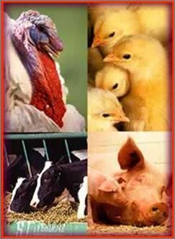

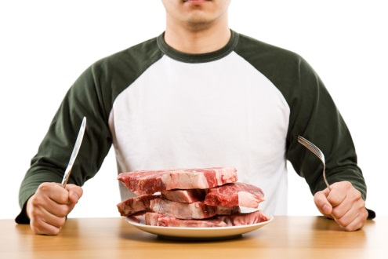

Qualitative Risk Assessment
Step 2. Exposure Assessment
Describes probability of human exposure to food-borne bacteria of human health concern through animal-derived food products

Slide 12
Exposure Assessment
Describes probability of human exposure to food-borne bacteria of human health concern through animal-derived food products
Evaluation based on
  Per capita consumption of food commodities (Table 2)
  Microbial contamination of those commodities
    Prevalence of zoonotic pathogens in commodity
Data sources for the Exposure Assessment
  USDA/FSIS Slaughter report (Tables 3 and 4 in GFI #152)
  NARMS (National Antimicrobial Resistance Monitoring System)
  Other surveillance systems such as CIPARS, EFSA, DANMAP, etc.
  Literature studies

Slide 13
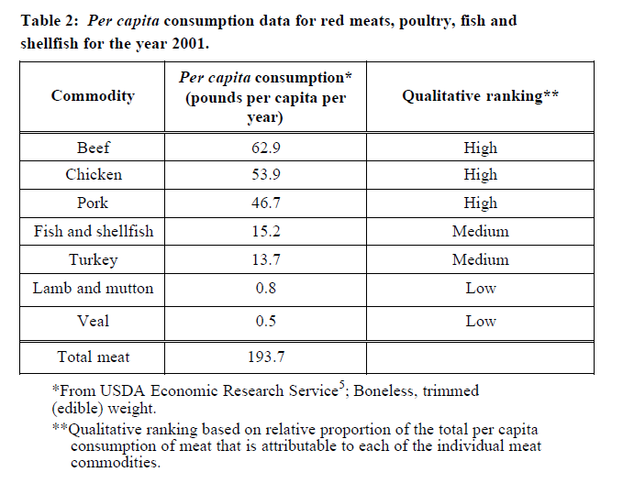
Table 2 GFI #152 Pg. 17

Slide 14
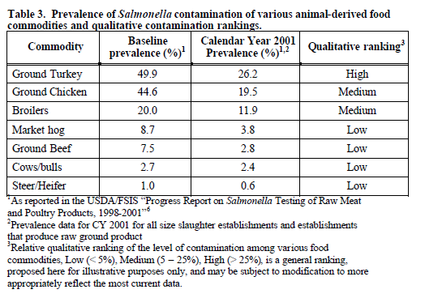
Contamination Rates from USDA/FSIS

Slide 15
Exposure Assessment
Per capita consumption of the food commodity
Probability of food commodity contamination
High
Medium
Low
High
Medium
Low
Medium

Slide 16



Qualitative Risk Assessment
Consequence Assessment
Describes human health consequence of exposure to resistant bacteria based on importance of drug (or related drugs) to humans (ranking of antimicrobials)

Slide 17

GFI #152, Consequence Assessment and Appendix A
Describes human health consequence of exposure to resistant bacteria based on importance of drug (or related drugs) to humans (ranking of antimicrobials).
Appendix A was developed in conjunction with FDA’s Center for Drug Evaluation and Research (CDER)
Importance of antimicrobial drugs according to their utility in human medicine- ranked as critically important, highly important or important
Qualitatively estimates the probability that human exposure to resistant bacteria will result in an adverse health consequence.
Based upon five criteria
Appendix A rankings are in the process of re-evaluation and are out for public comment. A public meeting is scheduled for November 16, 2020.

Slide 18
GFI #152 Consequence Assessment - Criteria for Ranking
  Antimicrobial drugs used to treat enteric pathogens that cause food-borne disease
  Sole therapy or one of few alternatives to treat serious disease or drug is essential component among many antimicrobials in the treatment of human disease
  Antimicrobials used to treat enteric pathogens in non-food-borne disease
  No cross-resistance within drug class and absence of linked resistance with other drug classes
  Difficulty in transmitting resistance elements within or across genera and species of organisms
  Critically important: Meet BOTH criteria 1 and 2
  Highly important: Meet either 1 or 2
  Important: Meet either criteria 3, 4, or 5

Slide 19
Drug Rankings and Examples
Critically Important
3rd Generation cephalosporins, macrolides, fluoroquinolones
Highly Important
aminoglycosides, clindamycin
Important
monobactams, quinolones

Slide 20
Qualitative Risk Integration
Release
Assessment
Risk Estimation
Exposure
Assessment
Consequence
Assessment
Risk estimation integrates results from release, exposure and consequence assessments to produce overall measure of risk associated with hazards.

Slide 21
 | GL 27 | GFI #152
Mechanism of activity | Basic Data | Release Assessment
Spectrum of activity | Basic Data | Release Assessment
PK/PD | Basic Data | Release Assessment
Resistance mechanisms | Basic Data | Release Assessment
Resistance transfer | Basic Data | Release Assessment
Co-selection | Basic Data | Release Assessment
Evaluation of Human Exposure | Additional Data | Exposure Assessment
Evaluation of Human Importance | Additional Data | Consequence Assessment

Slide 22
GFI #152 Risk Management mitigations based on level of risk estimation for new approvals
Approval conditions | Category 1 (High) | Category 2 (Medium) | Category 3 (Low)
Marketing Status | Rx | Rx/VFD | Rx/VFD/OTC
Extra-label use | Restricted | Restricted in some cases | Permitted
Extent of use | Low- Injectable- individual animals | Low, medium | Low, medium, high
Post-approval monitoring | NARMS | NARMS | In certain cases
Advisory committee review considered | Depends- first approval in class, etc | In certain cases | No

Slide 23
GFI #152 : Lessons Learned, Unique Challenges
Data gaps: Working with Sponsors to develop studies to address Data Gaps (Example: Danofloxacin NADA 141-207)
Assessing risks to public health from drugs proposed for use for the first time in food animals (no pre-existing baseline data; not in appendix A)
Whole genome sequencing (WGS): Predicted Resistance vs. AST
  Surveillance systems moving primarily to WGS, using the identification of antimicrobial resistance genes as predicted resistance
  Good validation for more common foodborne pathogens, less reliability for those not as often studied
  Clinical relevance of predicted resistance?
  Inability to monitor MIC creep – not scalable like MIC distribution data
  Drug Sponsor/Industry acceptance?

Slide 24
GFI #152 : Lessons Learned, Unique Challenges
Assessing risk to public health from drugs being co-developed in both human and food animals – no data on use in human medicine; not in appendix A
Drug:Bug interaction and host: may not be the same level of AMR risk from proposed uses across food animals, thus important to weigh risk appropriately and develop tailored risk management mitigations
Extent and duration of use- key drivers to AMR risk management and mitigating risk to public health; labels that look good on paper may not be practical in the animal husbandry environment

Slide 25
In Summary the Framework in GFI #152:
Considers an antimicrobial new drug to be ‘safe’ if it concludes that there is a reasonable certainty of no harm to public health from the proposed use of a drug in food-producing animals.
Is concerned about the decrease (or loss) in effectiveness of antimicrobial drugs in humans as a consequence of human exposure to resistant bacteria through the ingestion of animal derived products.
Provides a Qualitative Risk Assessment process to estimate the probability of the occurrence of the hazard.

Slide 26

Acknowledgements
CVM ONADE
Dr. Jeff Gilbert
Dr. Ruby Singh
Division of Human Food Safety
Microbial Food Safety Team
Heather Harbottle, Ph.D.
7500 Standish Place HFV-157
Rockville, MD 20855
heather.harbottle@fda.hhs.gov

